Slide 1
HEALTH BUDDY
PIP2001 Capstone Project
Review-4
Batch Number: CSE-G4
Under the Supervision of,
Mr. AMARNATH J L
Assistant Professor
School of Computer Science and Engineering
Presidency University
Roll Number | Student Name
20211CSE0086 | TULSI RAM REDDY K
20211CSE0085 | MANDADI VIGNESH
20211CSE0105 20211CSE0765 | CHALLA PAVAN TEJA SANNEBOINA ANJANEYALU
Name of the Program: CSE
Name of the HoD: Dr.Asif Mohammed H.B
Name of the Program Project Coordinator: Mr. Amarnath J.L & Dr. Jayanthi. K.
Name of the School Project Coordinators: Dr. Sampath A K / Dr. Abdul Khadar A / Mr. Md Ziaur Rahman

Slide 2
Content
Introduction
Literature Review
Proposed Method
Objectives
Methodology
Software Components
Timeline of the Project
Expected Outcomes
Algorithm
OutPut
Conclusion
References

Slide 3
Introduction
The Health Buddy application addresses the critical need for timely medical assistance by simplifying the search process during emergencies. By providing essential details about available services, medications, and specialist care, the app empowers users to make quick, informed decisions when every second counts. Ultimately, Health Buddy seeks to bridge the gap between individuals in need and accessible healthcare services, ensuring that help is just a tap away.

Slide 4
LITERATURE REVIEW
SL.NO | TITLE OF THE PAPER/AUTHOR/PUBLISHER/YEAR | ADVANTAGES | LIMITATIONS
1 | Amit Kumar Emergency Health Care Services in India: A Strategic Approach. International Journal for Multidisciplinary Research, Volume 6, Issue 1, January-February 2024, Pages 5-10. | Proposes a unified emergency surveillance system that integrates pre-hospital and facility-based care using telemedicine and emergency response technologies. | Fragmentation of healthcare services, lack of trained personnel, and insufficient infrastructure pose significant barriers to implementation.
2 | Kartik Mishra Mobile Health Apps and the Future of Emergency Medical Care in India. Journal of Mobile Technology in Healthcare, Volume 3, Issue 7, July 2020, Pages 21-28. | Utilizes mobile health apps with embedded AI algorithms to predict hospital crowding and suggest the best hospitals based on patient flow and emergency severity. | Data reliability is an issue due to the fragmented nature of the Indian healthcare system and the limited adoption of digital health technologies.

Slide 5
LITERATURE REVIEW(Contd..)
SL.NO | TITLE OF THE PAPER/AUTHOR/PUBLISHER/YEAR | ADVANTAGES | LIMITATIONS
3 | Naveen Sharma Emergency Response Systems in India: Leveraging Mobile Applications for Faster Access to Healthcare. Journal of Emergency Medical Services, Volume 7, Issue 3, July 2021, Pages 33-40. | Mobile apps connected to a centralized emergency response network to dispatch ambulances and guide users to the nearest hospitals. | Limited access in areas without strong mobile networks, and the system is reliant on real-time ambulance availability, which can cause delays during high-demand periods.
4 | Shruti Desai Optimization of Hospital Selection Algorithms for Emergency Medical Care in Urban India. Journal of Applied Algorithms and Computation, Volume 10, Issue 4, November 2020, Pages 47-54. | Develops algorithms that prioritize hospitals based on distance, specialty, and crowding factors, providing users with the optimal choice in emergency scenarios. | Real-time data accuracy is challenging in urban environments due to traffic congestion and frequent hospital overcrowding.

Slide 6
LITERATURE REVIEW(Contd..)
SL.NO | TITLE OF THE PAPER/AUTHOR/PUBLISHER/YEAR | ADVANTAGES | LIMITATIONS
5 | Suresh Patil Emergency Medical Care System Using GPS and Mobile Applications in Rural India. Journal of Healthcare Informatics Research, Volume 5, Issue 2, February 2020, Pages 62-70. | Implements a GPS-enabled emergency response system for rural India, integrating mobile apps with local healthcare centers for faster emergency responses. | Lack of reliable internet connectivity in rural areas hinders the app’s functionality, and local healthcare centers often face resource shortages.
6 | Anjali Bhatt The Role of Mobile Health Applications in Streamlining Emergency Medical Services in India. Journal of Health Technology, Volume 9, Issue 6, June 2022, Pages 35-42. | Mobile health applications connected with a central dispatch system to alert users about nearby hospitals and ambulances in emergencies. | Heavy reliance on mobile connectivity and challenges in synchronizing real-time data between private and government hospitals.

Slide 7
LITERATURE REVIEW(Contd..)
SL.NO | TITLE OF THE PAPER/AUTHOR/PUBLISHER/YEAR | ADVANTAGES | LIMITATIONS
7 | Zhao Jinxian et al , Subway Shield Construction Evaluation, Urban Infrastructure Journal, Vol 3(9): p 180-192, September 2023. | Proposes a general knowledge management system (KMS) for hospital settings to enhance decision-making through shared medical knowledge. | Requires a high degree of collaboration across medical teams, which can be difficult to achieve in practice.
8 | Lin et al., Knowledge Management in Healthcare Systems, Knowledge Systems Journal, Vol 8(5): p 300-315, May 2021. | Uses a fuzzy theory-based model combined with the WSR methodology to evaluate the effectiveness of infrastructure projects like emergency hospitals. | The complexity of the model makes it difficult to apply quickly in real-time emergency situations.

Slide 8
Proposed Method
An application will feature a user-friendly interface that allows for quick navigation and filtering of results, presenting detailed information, services, and reviews. By prioritizing data privacy and security, Health Buddy aims to enhance decision-making during emergencies and improve patient outcomes.

Slide 9
Objectives
develop a mobile application that provides lab tests for users for booking.
incorporate features that allow users to buy medications and also read health articles.
enhance decision-making capabilities during medical emergencies.
ensure user-friendly interface and seamless experience.

Slide 10
Methodology
The Hospital Buddy methodology begins with gathering critical user input, such as the type of medical emergency and shows the required medicine. Utilizing Java for backend processing and a MySQL database, the app fetches real-time data regardingmedications, including their available facilities and services.

Slide 11
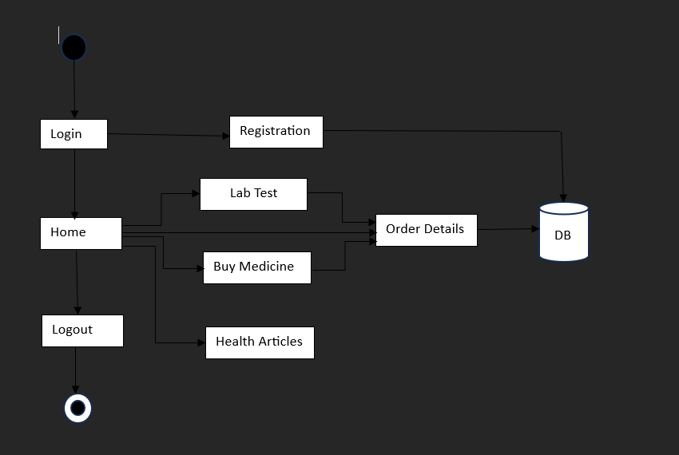
Architecture

Slide 12
Software Components
Platform:
Native Android Development using Android Studio.
UI/UX Design:
XML for designing user interfaces.
Programming Language:
Java.
Database:
Default MySQL Database of Android Studio.

Slide 13
Timeline of the Project
 | REVIEW - 0 |  |  |  | REVIEW - 1
 | 18-Sep-2024 |  |  |  | 21-Oct-2024
PLANNING
REQUIREMENT ANALYSIS
DESIGN
CODING
TESTING
DEPLOYMENT
PAPER PUBLICATION
REVIEW - 2 |  |  |  | REVIEW - 3
22-Nov-2024 |  |  |  | 20-Dec-2024
`
Final Viva-Voce
20-Dec-2024

Slide 14
Expected Outcomes
Real-Time Data Access: Users can access the lab tests and the medications required based on their needs.
User-Friendly Experience: A simple and intuitive interface will ensure that users can navigate the app easily, improving overall satisfaction and usability.
Increased Knowledge: The app will provide some basic and required information about how to maintain a healthy body using the health articles.
Integration with Emergency Services: Future updates may incorporate features for seamless communication with local emergency services to improve response times.

Slide 15
Algorithm
Input
Login
If user is not registered
go to registration
Else
go to home page
if lab test
go to lab test
if booking details are correct
booking successful
move o order details
else
provide correct information
elseif
buy medicines
go to buy medicines
if booking details are correct
booking successful
move to order details
else
provide correct information
elseif
articles
if yes
share details of particular articles
else
go back to home page
elseif
order details
display all orders which has been booked
else
logout
go to home page
end.

Slide 16
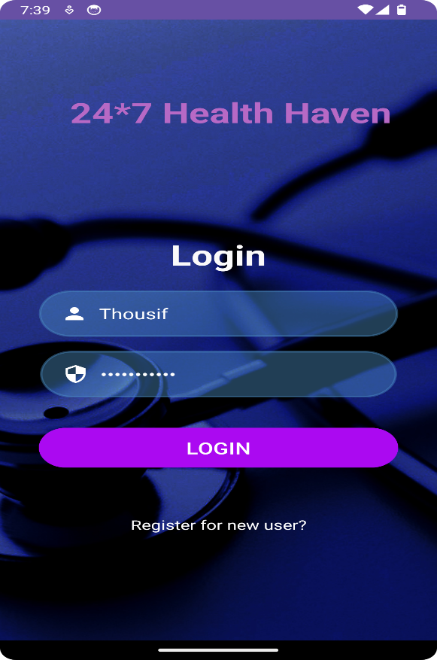
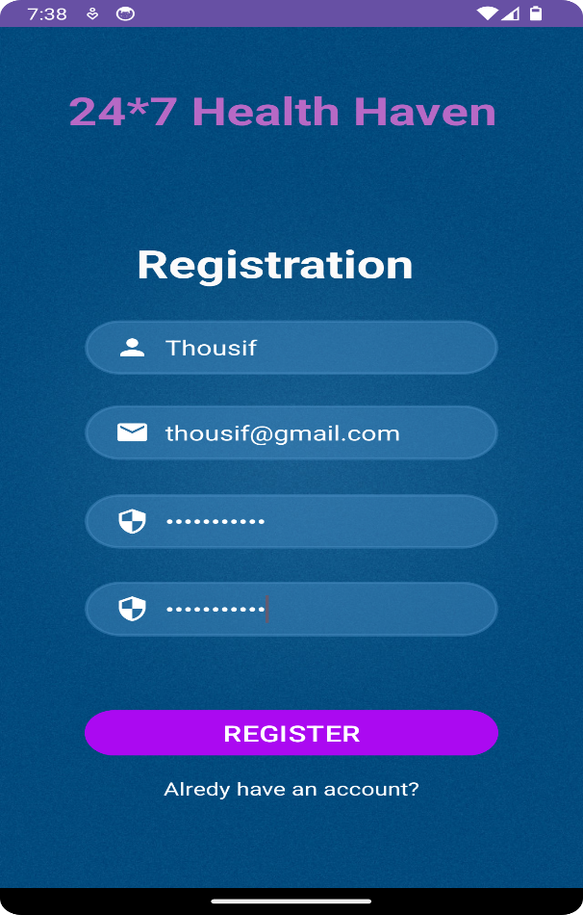
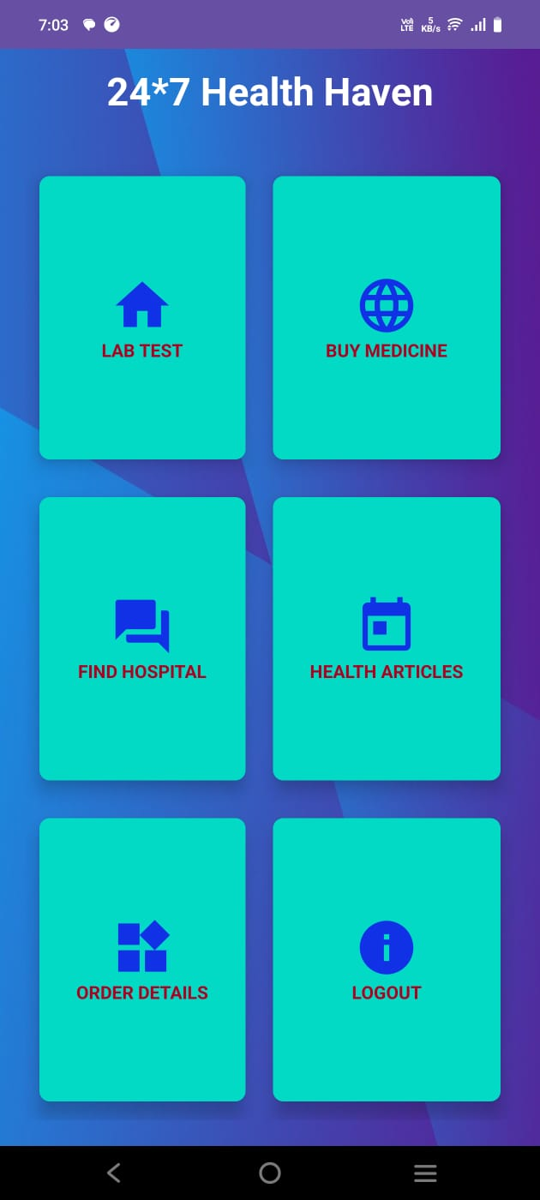
Output
Login page
Registration page
Home page

Slide 17
Conclusion
The proposed work represents a crucial advancement in improving healthcare access during medical emergencies. By providing users with real-time information about medications and health , the app empowers individuals to make informed decisions safely, which can be critical to patient outcomes. The emphasis on a user-friendly interface ensures that even in high-stress situations, users can navigate the app easily. Furthermore, the potential for integrating valuable data analytics offers insights that can drive future improvements, ultimately enhancing the overall efficiency of the healthcare system.

Slide 18
Github Link
The Github link provided should have public access permission.
Github Link :
https://github.com/RAM231103/HEALTH-BUDDY-

Slide 19
References
[1]. Arvind Mehta, Evaluating the Impact of E-Health Systems on Emergency Medical Services in India.Journal of Public Health Research, Volume 15, Issue 3, September 2021, Pages 15-22. https://jphr.com
[2]. Anjali Bhatt, The Role of Mobile Health Applications in Streamlining Emergency Medical Services in India.Journal of Health Technology, Volume 9, Issue 6, June 2022, Pages 35-42. https://jht.org
[3]. Shruti Desai, Optimization of Hospital Selection Algorithms for Emergency Medical Care in Urban India.Journal of Applied Algorithms and Computation, Volume 10, Issue 4, November 2020, Pages 47-54. https://jaac.org

Slide 20
References
[4]. Amit Kumar, Emergency Health Care Services in India: A Strategic Approach. International Journal for Multidisciplinary Research, Volume 6, Issue 1, January-February 2024, Pages 5-10. https://www.ijfmr.com
[5]. Kartik Mishra, Mobile Health Apps and the Future of Emergency Medical Care in India. Journal of Mobile Technology in Healthcare, Volume 3, Issue 7, July 2020, Pages 21-28. https://www.jmthc.com
[6]. Naveen Sharma, Emergency Response Systems in India: Leveraging Mobile Applications for Faster Access to Healthcare. Journal of Emergency Medical Services, Volume 7, Issue 3, July 2021, Pages 33-40. https://jems.com

Slide 21
Thank You

